Slide 1
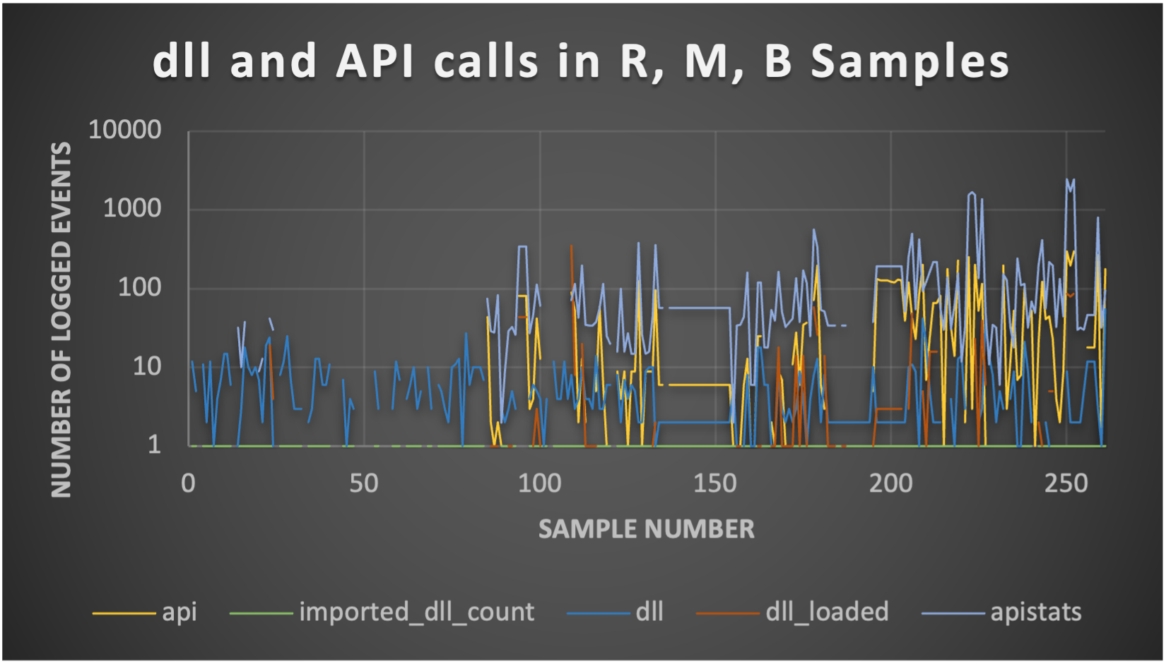
Benign Software
Malware
Ransomware

Slide 2
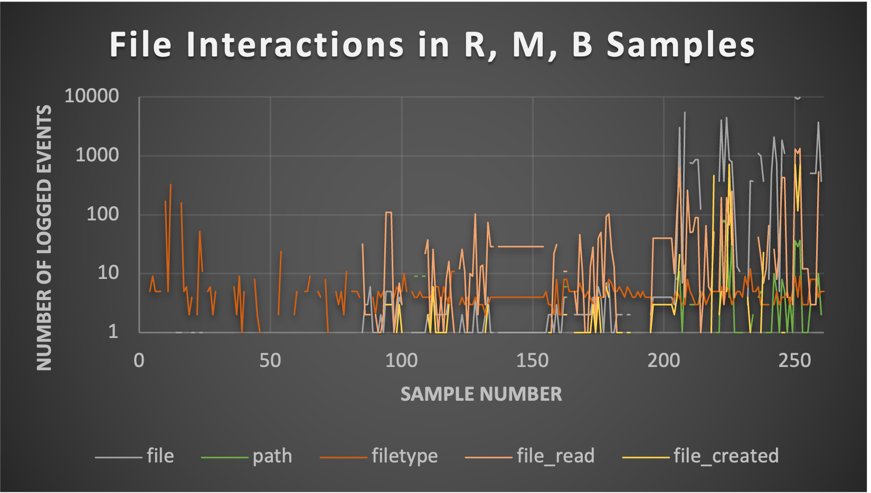
Benign Software
Malware
Ransomware

Slide 3
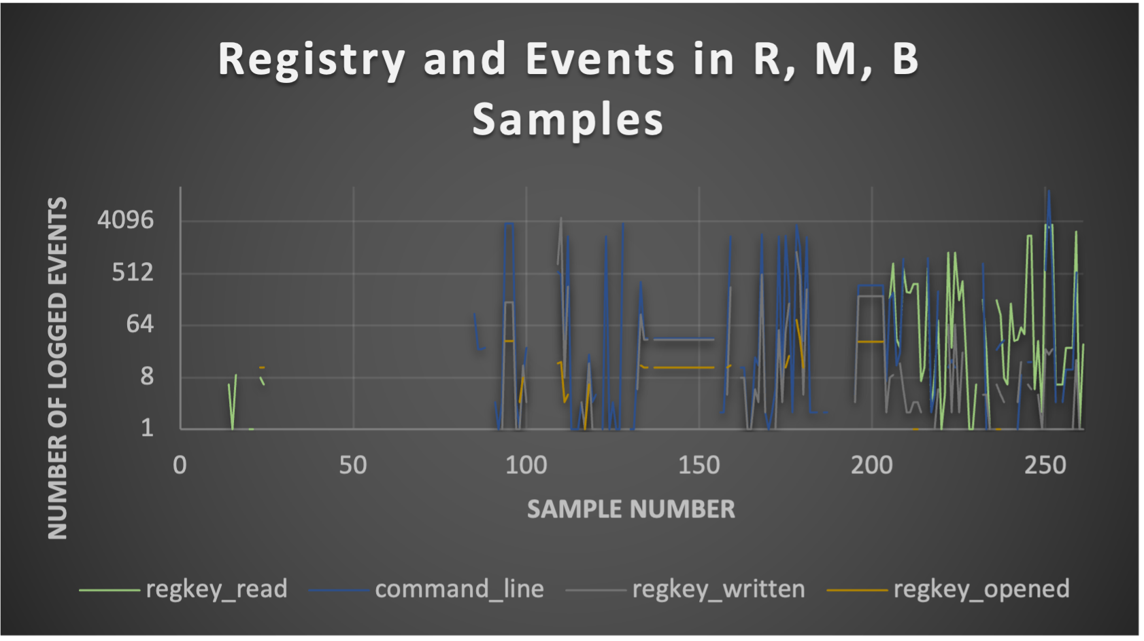
Benign Software
Malware
Ransomware

Slide 4
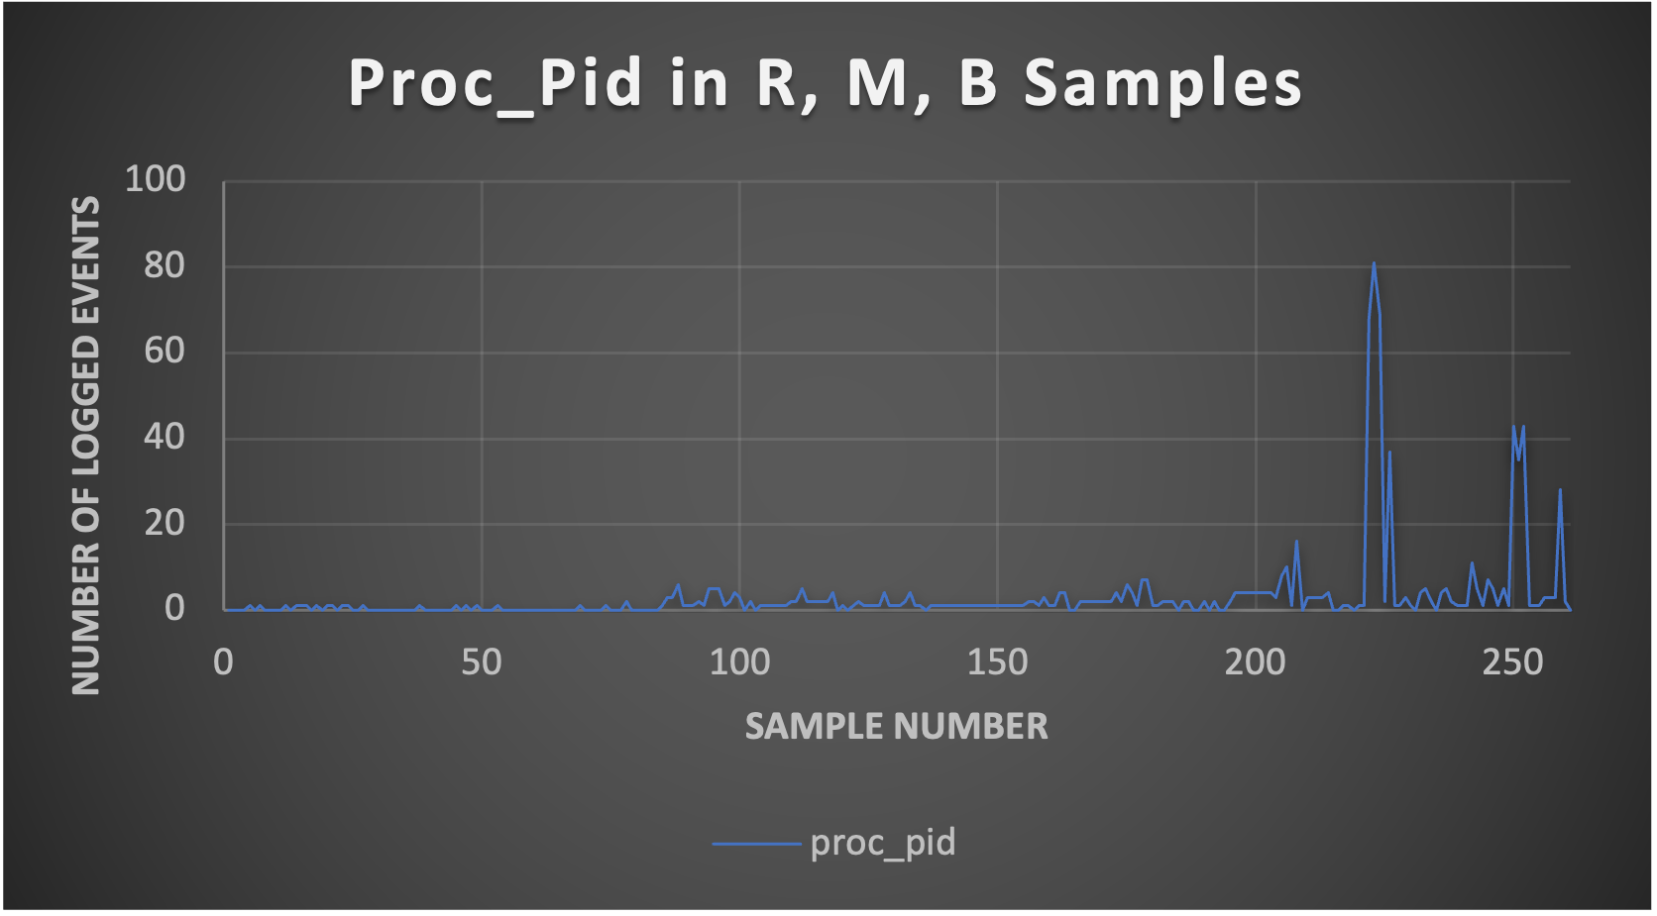
Benign Software
Malware
Ransomware

Slide 5
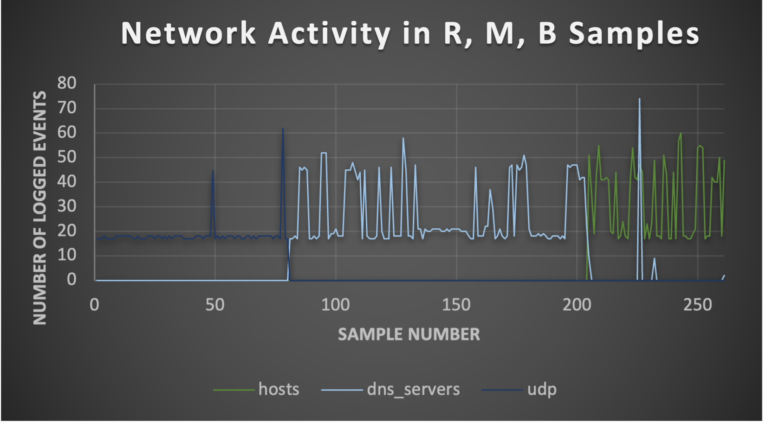
Benign Software
Malware
Ransomware

